Slide 1


Presentation On ERP Product for AIT as SaaS and Backend Design
Group Id : 64750
Group Number : 37
Guidance From : Prof. Satyadev Vyas
Project By:
130020107026 Darshit S Jasani
130020107065 Miloni S Patel
130020107086 Harshrajsinh V Rathod

Slide 2
INTRODUCTION
The basic idea is to create a Website as SaaS which provides all the best features of the college activities and it provides easy access to the Students, Parents, Admins and faculties so they can easily interact with eachother.
This website will runs on various Browsers and will be useful medium between faculty, HODs, administrative staff, Parents and the students.

Slide 3
PROBLEM STATEMENT
Students have to fill up forms and stand in queue to pay the fees.
Sometimes attendance taken in paper might be misplaced.
Parents from distant areas cannot monitor their child’s academic progress as it is difficult to keep watch all the time personally.

Slide 4
OBJECTIVES
Quicker availability of any kind of Information
related to College.
Improved end user quality of experience.
Quicker response time.
Simple User Interface.
Appropriate Data Safeguarding measured
Social media integration

Slide 5
RELATED BACKGROUND
If we visit current college website, it’ll take lot of time to find even small amount of information. Various data like exam dates and results are also not available in website.
Right now, Administration work is little time consuming. We will try our best to create swift way and paperless administration work.
Hence, the basic idea is to reduce the problems created while surfing the website and minimize the amount of effort the user has to put in to get the information.

Slide 6




TOOLS & TECHNOLOGY
Adobe Dreamweaver
Sublime Text 3
GNU Image Manipulation Program

Slide 7
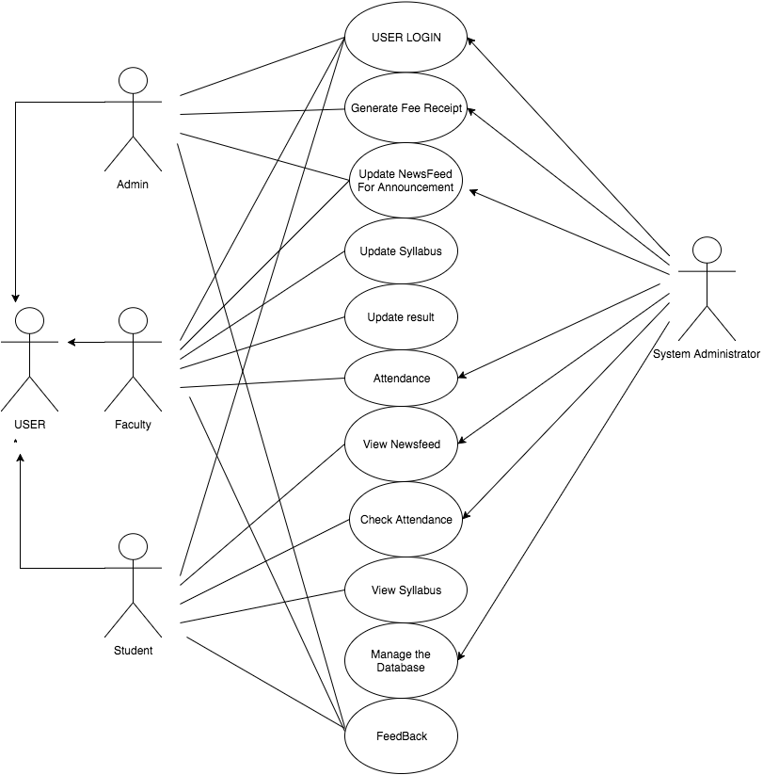
SYSTEM FLOWS
Use Case
Diagram

Slide 8
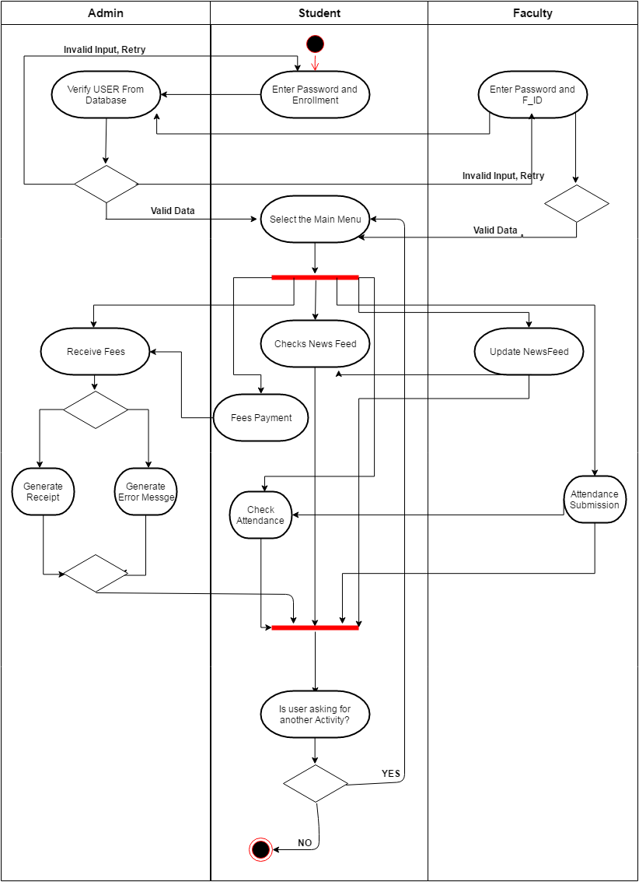
Activity
Diagram

Slide 9
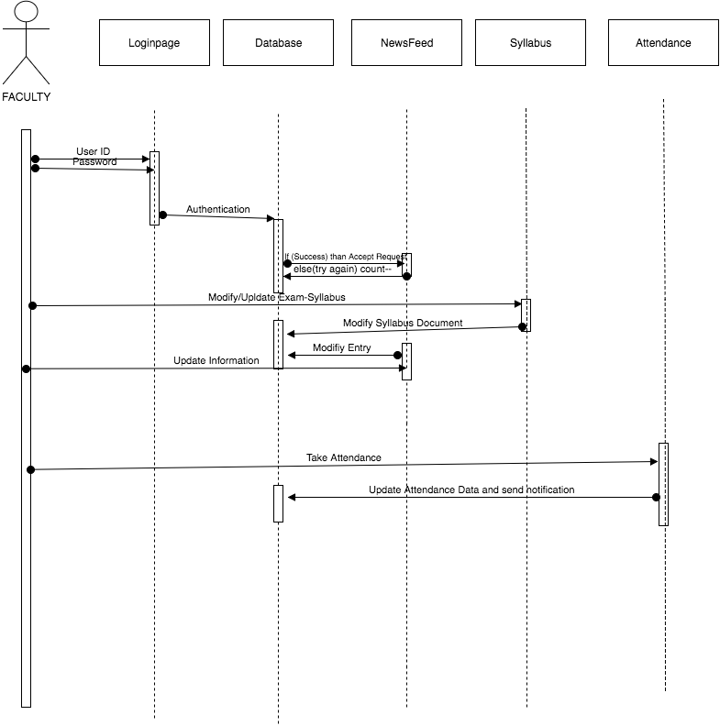
Sequence
Diagram

Slide 10
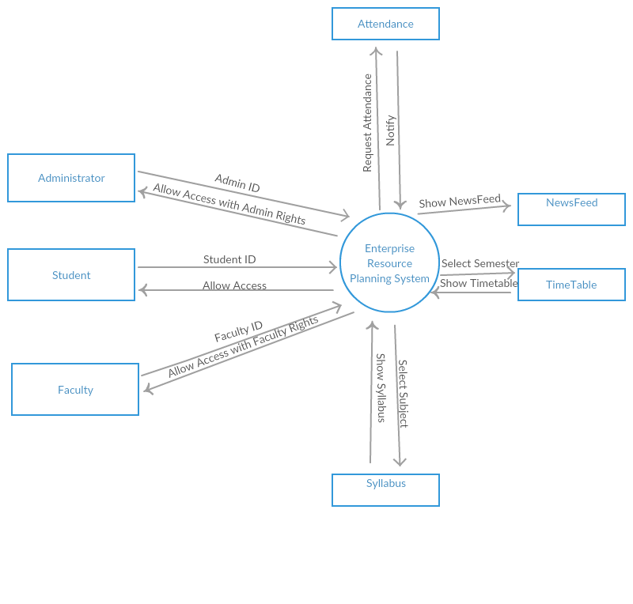
Context
Diagram

Slide 11
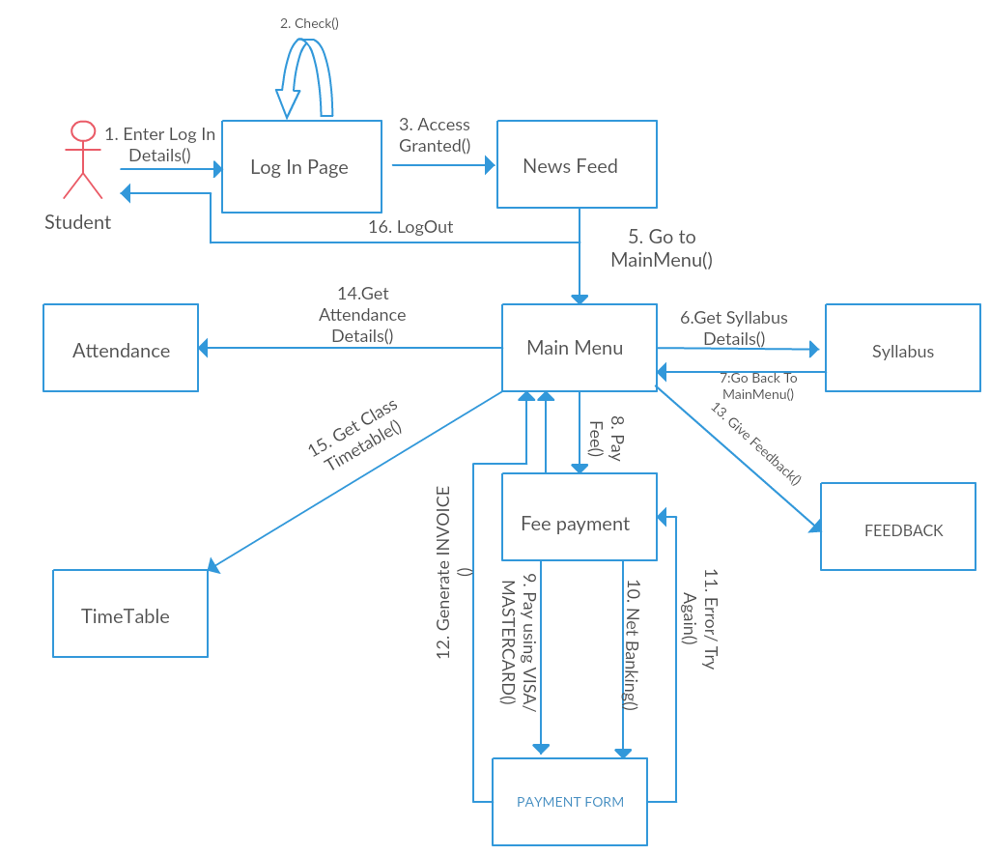
Collaboration
Diagram

Slide 12
MODULES IN PROJECT
Student
Admin
Parents/Guardians
Faculties
System Administrator

Slide 13
FEATURES
Newsfeed
Fees Payment
User friendly
Appropriate Data Safeguarding measured
Social Media Integration
Uncluttered GUI.

Slide 14
EXPECTED OUTCOMES
Core information available with reduced numbers of clicks.
Compatibility across bowsers
Seamless integration with users
Better co-ordination between Faculties and Students
Paperless work

Slide 15
ADVANTAGES
Explore possibilities of effective relationship between students and college.
Easy to take Attendance of students.
Helpful for Management and faculty team.
Any authenticated user can get needed data.
Make site look sleeker for user experience.

Slide 16
LIMITATIONS
Good internet connectivity required.
User must be authenticated to use the data.

Slide 17
FUTURE WORK
Available Library Books Record
Pay Canteen Bill Through Online Wallet
Forums
Student Placement activity
Events organization activity
Meetup activity
Volunteer registration

Slide 18
References
Google
Wikipedia
PHP Development by The New Boston .
Available: https://www.thenewboston.com/
Bootstrap by Bucky Roberts .
Available: https://www.buckyroberts.com/
SQL by W3schools .
Available: https://www.w3schools.com/
Robin Nixon, “PHP”, DreamTech publication, 2014.
David Maxwell, “SQL Bootcamp”, DreamTech publication, 2015.

Slide 19
Thank You

